Slide 1
Computer Networking
中地大计算机学院
陈喆
Email: chenzhe@cug.edu.cn
Tel: 13035110088
Notes:
1

Slide 2
Computer Networking
We think one important reason for this success has been that our book continues to offer a fresh and timely approach to computer networking instruction.
Notes:
2

Slide 3
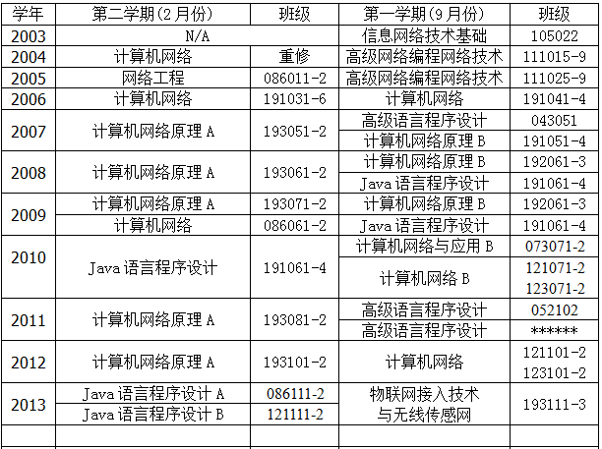
About me

Slide 4
计算机网络考研大纲
【考查目标】
掌握计算机网络的基本概念、基本原理和基本方法。
掌握计算机网络的体系结构和典型网络协议，了解典型网络设备的组成和特点，理解典型网络设备的工作原理
能够运用计算机网络的基本概念、基本原理和基本方法进行网络系统的分析、设计和应用

Slide 5
一、计算机网络体系结构
(一) 计算机网络概述
1. 计算机网络的概念、组成与功能
2. 计算机网络的分类
3. 计算机网络与互联网的发展历史
4. 计算机网络的标准化工作及相关组织
(二) 计算机网络体系结构与参考模型
1. 计算机网络分层结构
2. 计算机网络协议、接口、服务等概念
3. ISO/OSI参考模型和TCP/IP模型

Slide 6
二、物理层
(一) 通信基础
1. 信道、信号、宽带、码元、波特、速率等基本概念
2. 奈奎斯特定理与香农定理
3. 信源与信宿
4. 编码与调制
5. 电路交换、报文交换与分组交换
6. 数据报与虚电路
(二) 传输介质
1. 双绞线、同轴电缆、光纤与无线传输介质
2. 物理层接口的特性
(三) 物理层设备
1. 中继器
2. 集线器

Slide 7
三、数据链路层
(一) 数据链路层的功能
(二) 组帧
(三) 差错控制 1. 检错编码 2. 纠错编码
(四) 流量控制与可靠传输机制
1. 流量控制、可靠传输与滑轮窗口机制
2. 单帧滑动窗口与停止-等待协
3. 多帧滑动窗口与后退N帧协议(GBN)
4. 多帧滑动窗口与选择重传协议(SR)
(五) 介质访问控制
1. 信道划分介质访问控制 频分多路复用、时分多路复用、波分多路复用、码分多路复用的概念和基本原理
2. 随即访问介质访问控制 ALOHA协议；CSMA协议；CSMA/CD协议；CSMA/CA协议
3. 轮询访问介质访问控制：令牌传递协议

Slide 8
三、数据链路层
(六) 局域网
1. 局域网的基本概念与体系结构
2. 以太网与IEEE 802.3
3. IEEE 802.11
4. 令牌环网的基本原理
(七) 广域网
1. 广域网的基本概念
2. PPP协议
3. HDLC协议
4. ATM网络基本原理
(八) 数据链路层设备
1. 网桥
网桥的概念
透明网桥与生成树算法
源选径网桥与源选径算法
2. 局域网交换机及其工作原理。

Slide 9
四、网络层
(一) 网络层的功能
1. 异构网络互联
2. 路由与转发
3. 拥塞控制
(二) 路由算法
1. 静态路由与动态路由
2. 距离-向量路由算法
3. 链路状态路由算法
4. 层次路由
(三) IPv4
1.IPv4分组
2.IPv4地址与NAT
3.子网划分与子网掩码、CIDR
4.ARP协议、DHCP协议与ICMP协议
(四) IPv6
1.IPv6的主要特点
2.IPv6地址

Slide 10
四、网络层
(五)路由协议
1.自治系统
2.域内路由与域间路由
3.RIP路由协议
4.OSPF路由协议
5.BGP路由协议
(六)IP组播
1.组播的概念
2.IP组播地址
3.组播路由算法
(七)移动IP
1.移动IP的概念
2.移动IP的通信过程
(八)网络层设备
1.路由器的组成和功能
2.路由表与路由转发

Slide 11
五、传输层
(一) 传输层提供的服务
1. 传输层的功能
2. 传输层寻址与端口
3. 无连接服务与面向连接服务
(二) UDP协议
1. UDP数据报
2. UDP校验
(三) TCP协议
1. TCP段
2. TCP连接管理
3. TCP可靠传输
4. TCP流量控制与拥塞控制

Slide 12
六、应用层
(一)网络应用模型
1. 客户/服务器模型
2. P2P模型
(二) DNS系统
1.层次域名空间
2.域名服务器
3. 域名解析过程
(三)FTP
1. ftp协议的工作原理
2. 控制连接与数据连接
(四) 电子邮件
1.电子邮件系统的组成结构
2.电子邮件格式与MIME
3. SMTP协议与pop3协议
(五) WWW
1. WWW的概念与组成结构
2. HTTP协议

Slide 13
About the Course
Bilingual Course
Is not Computer English or Networking English
>=50% contents given in English, other given in Chinese
Grading
The final exam is close-book and in English, You can give the answer in English or in Chinese, as you prefer.
Final Exam: 70%
Homeworks: 20%
must be written on the exercise book
Present at the classes: 10%
Whoever breaks the school disciplines will be in for trouble!
Notes:
双语课程不是教大家学专业英语，而是用英语讲专业知识。我们这门课的教材、幻灯片、部分课堂内容用英语，遇到一些专业术语或限于我们的英语水平而无法用英语解释清楚的将以汉语给出。
如果能够克服困难、坚持下来的话，你将体会到用英文教材是一件惬意的事情。慢慢地你将会有这种体会，就是中文教材中很难理解的概念在外文教材中很容易被弄懂。外文学术文章不是文学作品，其目的是尽可能的让读者理解知识，没有复杂的语法。只要能够克服初期的不习惯并坚持下来，很快便能够体会到外文教材的好处。
在这门双语课程中，我们将尽量用双语把网络的基本概念、基本理论和Internet的相关知识介绍给大家，简单的概念用英语，复杂的知识用汉语。

Slide 14
Textbook, References Books
Textbook:
Computer Networking: A Top-Down Approach (5th Edition), Higher Education Press
计算机网络:自顶向下方法 (第四版),机械工业出版社
A Top Down Approach
Places the emphasis on the application layer.
Teaching networking applications near the beginning of the course is a powerful motivational tool.
Network application development can be given at an early stage.
Notes:
这本教材有两大特色：
一、自顶向下方法：
1、教材的重点放在了网络应用上，网络应用是网络飞速发展的推动。
2、这两个作者多年来一直从事计算机网络的教学工作，了解到学生更乐于了解网络应用的相关知识，如果学生了解了网络应用，就更容易理解支持网络应用所需的网络服务。
3、采用自顶向下的方法，可以使教师更早介绍网络应用的开发知识和技巧。学生们不仅能看到常用的网络应用如何工作，还能了解到开发应用程序其实并不困难。
二、Internet是焦点
这本教材使用了Internet的体系结构和协议作为研究网络基本概念的主要载体，采用了TCP/IP参考模型而不是ISO的OSI参考模型

Slide 15
Textbook, References Books
An Internet Focus
Use the Internet’s architecture and protocols as primary vehicles for studying fundamental concepts.
Addressing Principles
The field of networking is now mature enough that a number of fundamentally important issues can be identified.
The student learning these principles will gain knowledge with a long “shelf life”.
The combination of using the Internet to get the student’s foot in the door and then emphasizing fundamental issues and solution approaches will allow the student to quickly understand just about any networking technology.
Notes:
这本教材有两大特色：
一、自顶向下方法：
1、教材的重点放在了网络应用上，网络应用是网络飞速发展的推动。
2、这两个作者多年来一直从事计算机网络的教学工作，了解到学生更乐于了解网络应用的相关知识，如果学生了解了网络应用，就更容易理解支持网络应用所需的网络服务。
3、采用自顶向下的方法，可以使教师更早介绍网络应用的开发知识和技巧。学生们不仅能看到常用的网络应用如何工作，还能了解到开发应用程序其实并不困难。
二、Internet是焦点
这本教材使用了Internet的体系结构和协议作为研究网络基本概念的主要载体，采用了TCP/IP参考模型而不是ISO的OSI参考模型

Slide 16
Textbook, References Books
Reference books
Behrouz A.Forouzan, Data Communications and Networking (Fourth Edition) 机械工业出版社 2006.7
Larry L.Peterson, Computer Networks: A System Approach (Fourth Edition) 机械工业出版社 2007.5
《计算机网络: 网络设计的原理、技术和协议》机械工业出版社 2008.1
Andrew S. Tanenbaum, Computer Networks, 4th edition, 清华大学出版社 2004.8
《计算机网络》 (第四版) (Andrew S. Tanenbaum著 潘爱民译，清华大学出版社 2004.8
Douglas E. Comer, Computer Networks and Internets, (Fourth Edition) 电子工业出版社, 2004.6
Notes:
这本教材有两大特色：
一、自顶向下方法：
1、教材的重点放在了网络应用上，网络应用是网络飞速发展的推动。
2、这两个作者多年来一直从事计算机网络的教学工作，了解到学生更乐于了解网络应用的相关知识，如果学生了解了网络应用，就更容易理解支持网络应用所需的网络服务。
3、采用自顶向下的方法，可以使教师更早介绍网络应用的开发知识和技巧。学生们不仅能看到常用的网络应用如何工作，还能了解到开发应用程序其实并不困难。
二、Internet是焦点
这本教材使用了Internet的体系结构和协议作为研究网络基本概念的主要载体，采用了TCP/IP参考模型而不是ISO的OSI参考模型

Slide 17
Textbook, References Books
William Stallings, Wireless Communications and Networks (Second Edition) 电子工业出版社 2006.8
Jochen Schiller, Mobile Communications (Second Edition) 高等教育出版社, 2004.3
《计算机网络》(第四版) 谢希仁 电子工业出版社 2004.6
《全新宽带IP网络技术教程》王宝智等 海洋出版社 2004.1
《高速网络与互联网 — 性能分析与服务质量》(第二版) 电子工业出版社 齐望东 等译 2003.1
《下一代计算机网络技术》周伯杨等 国防工业出版社 2006.1

Slide 18
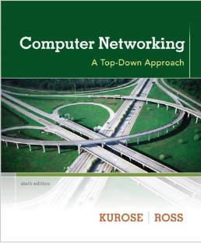
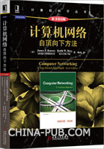
Textbook (计算机网络原理A)
Notes:
Computer Networking: A Top-Down Approach, 4/E James F. Kurose, University of Massachusetts, Amherst Keith W. Ross, Polytechnic University, Brooklyn
ISBN-10: 0321497708 ISBN-13: 9780321497703
Publisher: Addison-Wesley Copyright: 2008 Format: Cloth; 880 pp Published: 03/23/2007
Computer Networking: A Top-Down Approach, 5/E James F. Kurose, University of Massachusetts, Amherst Keith W. Ross, Polytechnic University, Brooklyn
ISBN-10: 0136079679
ISBN-13: 9780136079675
Publisher: Addison-Wesley
Copyright: 2010
Format: Cloth; 864 pp
Published: 03/23/2009

Slide 19
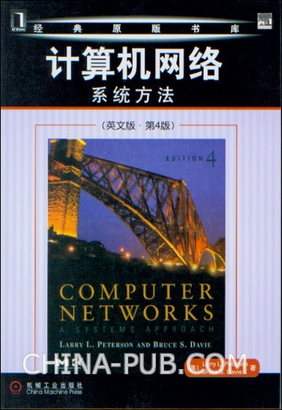
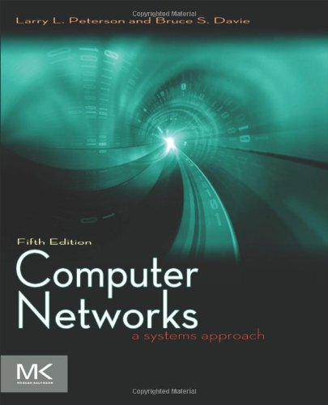
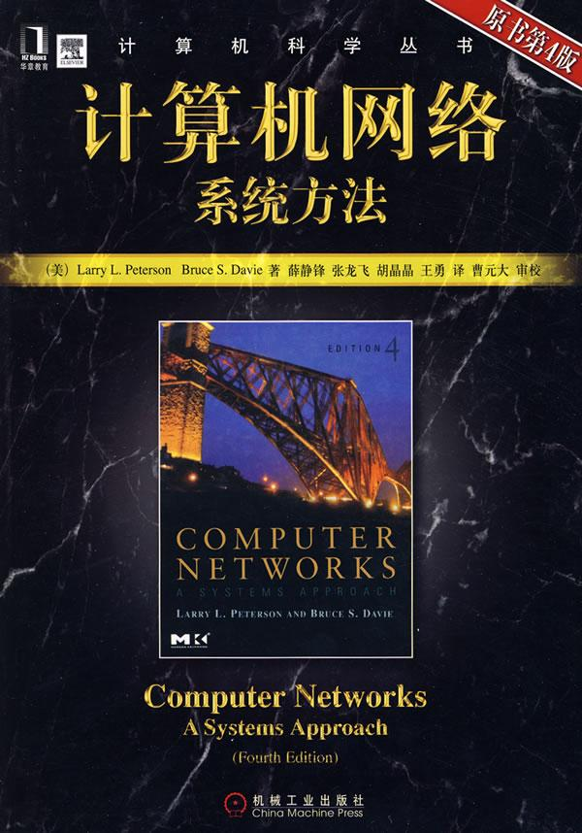
Textbook(计算机网络原理A)
Notes:
Foreword
— David Clark, Massachusetts Institute of Technology
It is now ten years since the classic book first appeared.
Looking back, it is amazing what has happened in that time.
We have seen the transformation of the Web from a small experiment to a World Wide phenomenon.
We have seen the emergence of voice over IP and peer-to-peer content sharing.
We have seen technology speed up a hundred-fold (n.百倍,百重; 宾语从句), the emergence of broadband to the home, and the rise of botnets and other horrid security problems.
Many things have changed, technology has come and gone, and (perhaps equally amazing) much of the basics of the Internet are still there.
This book, too, has changed much in ten years, with the four editions to keep up.
But the basic value of the book remains the same as the first edition.
This book gives you the facts you need, and puts those facts into the larger context so that the knowledge you gain will be of value even as the details change.
Reading this book informs you about today and prepares you for tomorrow.
One new feature is a set of sidebars that illustrate the context of ideas being presented in the text — the why of the ideas. Why did an idea fail? Why did it succeed?
What has changed in the book?
Some technologies have faded from sight, and get less attention in this edition. We bid a fond farewell to FDDI and ATM LANs.
Some technologies have mutated and emerged in new forms.
Remote Procedure Call is no longer a LAN-based low-level invocation mechanism, but the foundation of Internet-wide Web Services.
We welcome gigabit Ethernet, an updated and expanded section on wireless, and more on router implementation.
The material on TCP is up to date, with discussion of new acknowledgement schemes and extensions for high speed.
With the increasing concern with security, there is a completely revised chapter with a new emphasis on a systems approach to security, and a discussion of threats and how to counter them.
And at the end, there is a chapter that helps you “put it all together,” using case studies at the application layer (VoIP, multimedia, and peer to peer) to show how all the concepts from the previous chapters combine to provide the system that supports these applications.
The evolution of networks is not going to slow down. Soon we will be talking about the impact of television over IP, the collision of the Internet and sensor networks, and lots of other very new and exciting ideas. But relax — if you read this book today you will have the insights you need for tomorrow.

Slide 20


Top 4 Computer Network Books Compared
Notes:
Top 4 Computer Network Books Compared
This review compares the following four books:
Computer Networking by Kurose and Ross (K R)
Computer Networks by Peterson and Davie (P D)
Computer Networks and Internets / Internetworking with TCP/IP by Comer
Computer Networks by Tanenbaum
By far the best book in the list is "Computer Networking" by Kurose and Ross.
This book covers all of the essential material that is in the other books but manages to do so in a relevant and entertaining way.
This book is very up to date as seen by the release of the 5th Ed when the 4th Ed is barely two years old. There are lots of practical exercises using Wireshark and the companion website is actually useful and relevant.
The attitude of this book with regard to teaching networking concepts could be summed up as "try it out and see for yourself".
One interesting thing to note is that the socket programming example are all in Java.
Next up is the Peterson and Davie book which covers everything that Kurose and Ross discuss but is slightly more mathematical in how it goes about things.
There are a lot more numerical examples and defining of formulas in this book which is fine by me and in no way detracts from the book.
Also the socket programming examples are in C which is a little more traditional.
The points where this text loses ground to K R is that it doesn't have the practical application exercises that K R has and it also doesn't extend the basic networking theory that is covered to modern protocols like K R.
The two Comer books come next.
Comer's "Computer Networks" book is probably the most introductory book out of this whole list and is more of a survey of networking topics that doesn't cover anything in any real depth.
Still, this is an excellent book in that it is a quick clear read that is very lucid in its explanations and you can't help feeling that you understand everything that is covered in the book.
Comer's TCP/IP book is the equivalent of the other authors' computer network books and in that respect it is pretty average. It covers all of the relevant material and in a manner which is more than readable but that is all.
There is nothing exceptional about the book which stands out from the rest.
Last comes Tanenbaum's book from the author who is probably most famous for his OS books.
This is probably the most technical and detailed of the books with lots of sample C code belying his experience with operating systems and their network stack code.
The weak point of this book is that all of the code and technical minutia might prevent the reader from seeing the forest for the trees.
Unless you are trying to learn how to program your own network stack for a Unix/Linux system, then I would get either the K R book or the P D book to learn networking for the first time.
This book would best be served as a reference in which case the technical nature of the book becomes a benefit rather than detracting from the text.
More Fun than Sudoku Puzzles
This book is a thoroughly enjoyable learning experience!!! I bought this book before Christmas out of curiosity and out of a potential need to learn more about computer networking and brush up on it when asked about it on a technical interview.
Since I already had certified as a Java Enterprise Architect, which required knowledge of Java 2 Network Security and protocols such as HTTP, HTTPS, IIOP, JRMP, I had some limited, specialized knowledge of network protocols. However, this book really gave me much more background on the Internet than I had anticipated and it broadened my perspective about future technology developments, which will probably continue to be born out of the Internet.
Should it be no surprise that a language such as Java, which started out as a network programming language has become much more than that? No doubt the Internet has proven to be much larger of an influence in the world than ever expected. For example, years ago I remember reading about the seven-layer ISO OSI reference model using in data communications in telecommunications.
This book made it clear that this has all been compacted into a five-layer Internet protocol stack. Something arcane and mystical has been simplified and is very public domain.
This book covers the five-layer protocol stack: Application Layer, Transport Layer, Network Layer, Link Layer, and Physical Layer. I thought I might be turned off by some of the geeky topics in the network protocols, but instead I found them quite tasty too and I gobbled up the whole book.
The introduction chapter outlined most of the topics covered in later chapters such as each of the layer protocols and then topics that build on them such as security, wireless and mobile networks, multimedia networking, and network management.
Some of my major learning experiences included: DSL, circuit switching, packet switching, application protocols, DNS servers, socket programming using either TCP or UDP, building reliable data transfer protocols such as TCP, TCP congestion control, routers, IPv4 and IPv6, routing algorithms, designing subnet IP addresses, network interface cards/MAC addresses, Ethernet protocol details, and then some.
I also used the book's programming assignment downloads, and Ethernet Wireshark labs, study guides and self-assessment tests. All of this really anchors and expands upon the topics covered in each chapter. This book and the online learning aids was more fun and brain expanding than sudoku puzzles!
good book to read
This book is very easy to understand, but some of the assignment is challenge. I learn a lot from this book.
A good book for CS/EE student to begin studying Computer Networks
Good book for those students who wishes to take computer/data network courses, and also helpful to those who wishes to take the CISCO exams.
Keith Ross is one of the best professors I've known so far, and he totally rocks!
Excellent Book for Networking Fundamentals
Coming from an Electronic Engineering Background and having passed the CCNA exam I wanted to fill in some of the networking gaps as I'm not from an IT background.
I've found this book gave an excellent explanation on Application level and Security which are not covered in the CCNA.
This is an excellent reference book for all 7 layers of the OSI model and I would highly recommend it for people migrating into a networking role or wishing to gain a solid understanding of networking fundamentals.

Slide 21

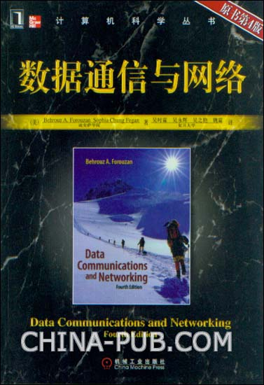
Reference Books
Notes:
Editorial Reviews — Product Description As one of the fastest growing technologies in our culture today, data communications and networking presents a unique challenge for instructors.
As both the number and types of students are increasing, it is essential to have a textbook that provides coverage of the latest advances, while presenting the material in a way that is accessible to students with little or no background in the field.
Using a bottom-up approach, Data Communications and Networking presents this highly technical subject matter without relying on complex formulas by using a strong pedagogical approach supported by more than 700 figures.
Now in its Fourth Edition, this textbook brings the beginning student right to the forefront of the latest advances in the field, while presenting the fundamentals in a clear, straightforward manner.
Students will find better coverage, improved figures and better explanations on cutting-edge material.
The "bottom-up" approach allows instructors to cover the material in one course, rather than having separate courses on data communications and networking.
This new networking text follows a top-down approach.
The presentation begins with an explanation of the application layer, which makes it easier for students to understand how network devices work, and then, with the students fully engaged, the authors move on to discuss the other layers, ending with the physical layer.
With this top-down approach, its thorough treatment of the topic, and a host of pedagogical features, this new networking book offers the market something it hasn't had for many years- a well-crafted, modern text that places the student at the center of the learning experience.
Forouzan's Computer Networks presents a complex topic in an accessible, student-friendly way that makes learning the material not only manageable but fun as well.
The appealing visual layout combines with numerous figures and examples to provide multiple routes to understanding.
Students are presented with the most up-to-date material currently available and are encouraged to view what they are learning in a real-world context.
This approach is both motivating and practical in that students begin to see themselves as the professionals they will soon become.

Slide 22
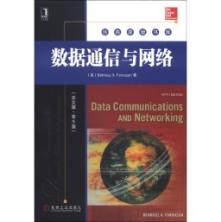
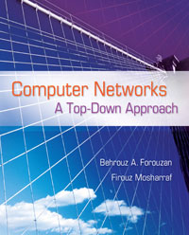
Reference Books
Notes:
Editorial Reviews — Product Description As one of the fastest growing technologies in our culture today, data communications and networking presents a unique challenge for instructors.
As both the number and types of students are increasing, it is essential to have a textbook that provides coverage of the latest advances, while presenting the material in a way that is accessible to students with little or no background in the field.
Using a bottom-up approach, Data Communications and Networking presents this highly technical subject matter without relying on complex formulas by using a strong pedagogical approach supported by more than 700 figures.
Now in its Fourth Edition, this textbook brings the beginning student right to the forefront of the latest advances in the field, while presenting the fundamentals in a clear, straightforward manner.
Students will find better coverage, improved figures and better explanations on cutting-edge material.
The "bottom-up" approach allows instructors to cover the material in one course, rather than having separate courses on data communications and networking.
This new networking text follows a top-down approach.
The presentation begins with an explanation of the application layer, which makes it easier for students to understand how network devices work, and then, with the students fully engaged, the authors move on to discuss the other layers, ending with the physical layer.
With this top-down approach, its thorough treatment of the topic, and a host of pedagogical features, this new networking book offers the market something it hasn't had for many years- a well-crafted, modern text that places the student at the center of the learning experience.
Forouzan's Computer Networks presents a complex topic in an accessible, student-friendly way that makes learning the material not only manageable but fun as well.
The appealing visual layout combines with numerous figures and examples to provide multiple routes to understanding.
Students are presented with the most up-to-date material currently available and are encouraged to view what they are learning in a real-world context.
This approach is both motivating and practical in that students begin to see themselves as the professionals they will soon become.

Slide 23
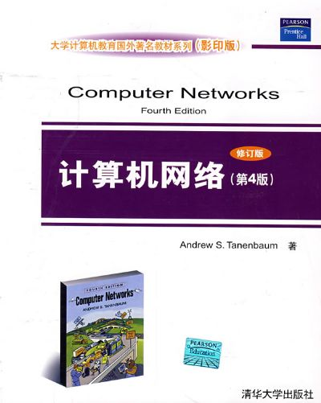
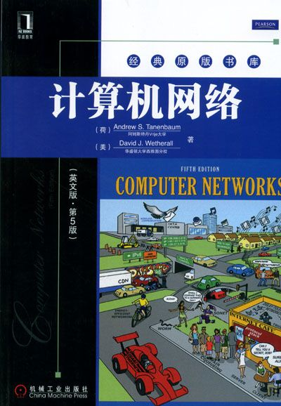
Reference Books

Slide 24
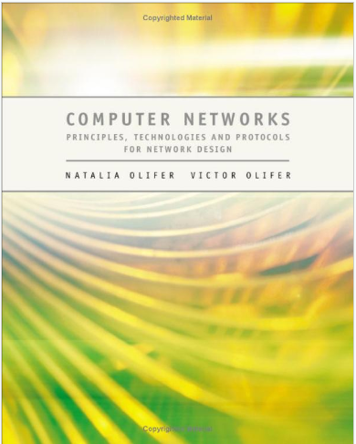

Reference Books
Notes:
计算机网络：网络设计的原理、技术和协议ISBN：7-111-22885-1作者：Natalia Olifer; Victor Olifer 译者：高传善出版日期：2007-12-30目录：译者序 译者简介 前言 第一部分 网络基础 第1章 计算机网络的发展 2 1.1 引言 2 1.2 计算机网络的起源 2 1.2.1 计算机网络是计算和通信技术 发展的产物 2 1.2.2 批处理系统 3 1.2.3 多终端系统：计算机网络的原型 3 1.3 第一代计算机网络 4 1.3.1 第一代广域网(WAN) 4 1.3.2 第一代局域网(LAN) 6 1.4 网络融合 7 1.4.1 LAN和WAN的融合 7 1.4.2 计算机网络和电信网络的融合 9 小结 10 复习题 10 练习题 11 第2章 网络设计的一般原理 12 2.1 引言 12 2.2 共享计算机资源的问题 12 2.2.1 计算机与外部设备间的交互作用 12 2.2.2 两个计算机间最简单的交互作用 14 2.2.3 网络应用程序 16 2.3 使用通信链路的物理数据传输的 问题 17 2.3.1 编码 18 2.3.2 物理链路的特性 19 2.4 多台计算机交互的问题 20 2.4.1 物理链路的拓扑 20 2.4.2 网络节点的编址 22 2.4.3 交换 24 2.5 通用的交换问题 24 2.5.1 流定义 24 2.5.2 路由 25 2.5.3 数据转发 27 2.5.4 多路复用和解多路复用 28 2.5.5 共享介质 29 2.5.6 交换类型 30 小结 31 复习题 31 练习题 32 第3章 分组和电路交换 33 3.1 引言 33 3.2 电路交换 33 3.2.1 连接建立 34 3.2.2 建立请求的阻塞 34 3.2.3 保证带宽 34 3.2.4 多路复用 35 3.2.5 传送突发流量的低效率 39 3.3 分组交换 37 3.3.1 缓存与队列 37 3.3.2 分组转发方法 39 3.3.3 数据报传输 39 3.3.4 逻辑连接 41 3.3.5 虚电路 41 3.3.6 电路交换网络与分组交换网络 的比较 43 3.4 在共享介质网络中的分组交换 48 3.4.1 介质共享的原理 48 3.4.2 LAN结构的理由 49 3.4.3 LAN的物理构造 50 3.4.4 共享介质网络的逻辑构造 51 3.4.5 作为标准技术例子的以太网 53 小结 54 复习题 55 练习题 55 第4章 网络体系结构与标准 57 4.1 引言 57 4.2 网络节点互动的分解 57 4.2.1 多层的方法 57 4.2.2 协议和协议栈 59 4.3 OSI模型 60 4.3.1 OSI模型的一般特性 60 4.3.2 物理层 62 4.3.3 数据链路层 62 4.3.4 网络层 63 4.3.5 运输层 66 4.3.6 会话层 67 4.3.7 表示层 67 4.3.8 应用层 67 4.3.9 OSI模型和电路交换网络 67 4.4 网络标准 67 4.4.1 开放系统的概念 68 4.4.2 标准的类型 68 4.4.3 因特网标准 69 4.4.4 通信协议的标准栈 69 4.4.5 流行协议栈与OSI模型间的对应 关系 74 4.5 信息和运输服务 75 4.5.1 网络元素的协议分布 76 4.5.2 运输系统的辅助协议 77 小结 78 复习题 78 练习题 79 第5章 网络的例子 80 5.1 引言 80 5.2 电信网络的一般结构 80 5.2.1 接入网 81 5.2.2 主干 81 5.2.3 数据中心 81 5.3 电信运营商网络 82 5.3.1 服务 82 5.3.2 客户 83 5.3.3 基础结构 84 5.3.4 覆盖的范围 85 5.3.5 不同类型运营商间的关系 85 5.4 公司网络 86 5.4.1 部门网 87 5.4.2 楼宇或校园网 87 5.4.3 企业范围的网络 88 5.5 因特网 90 5.5.1 因特网的独特性 90 5.5.2 因特网的结构 91 5.5.3 因特网的边界 93 小结 95 复习题 95 练习题 96 第6章 网络的特性 97 6.1 引言 97 6.2 特性的类型 97 6.2.1 主观质量特性 97 6.2.2 网络特性和要求 98 6.2.3 时间尺度 98 6.2.4 服务水平约定 99 6.3 性能 99 6.3.1 理想的网络 99 6.3.2 分组延迟的特性 101 6.3.3 信息率的特性 103 6.4 可靠性 104 6.4.1 分组丢失特性 104 6.4.2 可用性和容错 104 6.4.3 可替换的路由 105 6.4.4 数据重传和滑动窗口 106 6.5 安全 108 6.5.1 计算机和网络安全 109 6.5.2 数据保密性、完整性和可用性 109 6.5.3 网络安全服务 110 6.6 仅用于服务提供商的特性 111 6.6.1 可扩展性和可延拓性 111 6.6.2 可管理性 112 6.6.3 兼容性 112 小结 112 复习题 113 练习题 113 第7章 保证服务质量的方法 114 7.1 引言 114 7.2 应用与QoS 114 7.2.1 不同类型应用的QoS要求 114 7.2.2 信息率的可预测性 115 7.2.3 应用对分组延迟的敏感性 116 7.2.4 应用对分组丢失的敏感性 116 7.2.5 应用类别 117 7.3 队列分析 117 7.3.1 M/M/1模型 118 7.3.2 作为分组处理模型的M/M/1 119 7.4 QoS机制 121 7.4.1 在低负载方式下运行 121 7.4.2 不同的服务类别 121 7.5 队列管理算法 122 7.5.1 FIFO算法 122 7.5.2 优先权排队 122 7.5.3 加权排队 124 7.5.4 混合的排队算法 125 7.6 反馈 125 7.6.1 目的 125 7.6.2 反馈参与者 126 7.6.3 反馈信息 127 7.7 资源预留 128 7.7.1 资源预留和分组交换 128 7.7.2 基于预留的QoS系统 131 7.8 流量工程 133 7.8.1 传统路由方法的不足 133 7.8.2 流量工程的思想 134 7.8.3 不同流量类别的流量工程 136 小结 137 复习题 137 练习题 137 第二部分 物理层技术 第8章 传输链路 140 8.1 引言 140 8.2 分类 140 8.2.1 传输网、电路和链路 140 8.2.2 介质 141 8.2.3 传输设备 142 8.3 传输链路特性 143 8.3.1 通信链路中信号的频谱分析 143 8.3.2 衰减与阻抗 145 8.3.3 抗噪声与传输可靠性 146 8.3.4 带宽与容量 148 8.3.5 比特与波特 149 8.3.6 带宽与容量间的相关性 150 8.4 电缆类型 151 8.4.1 非屏蔽和屏蔽双绞线 151 8.4.2 同轴电缆 152 8.4.3 光缆 153 8.4.4 楼宇的结构化布线系统 154 小结 155 复习题 155 练习题 156 第9章 数据编码和多路复用 157 9.1 引言 157 9.2 调制 157 9.2.1 传输模拟信号时的调制 157 9.2.2 传输离散信号时的调制 157 9.2.3 组合调制方式 158 9.3 数字化模拟信号 160 9.3.1 脉冲编码调制 160 9.3.2 数字化声音 161 9.4 编码方法 161 9.4.1 选择编码方法 161 9.4.2 电平不归零码 162 9.4.3 双极标记交替反转编码 163 9.4.4 “1”翻转的不归零码 163 9.4.5 双极脉冲编码 164 9.4.6 曼彻斯特编码 164 9.4.7 2B1Q电平码 164 9.4.8 冗余码 165 9.4.9 扰频 165 9.4.10 数据压缩 167 9.5 差错检测与校正 168 9.5.1 差错检测技术 168 9.5.2 差错校正 169 9.6 多路复用和交换 169 9.6.1 基于FDM和WDM的电路交换 170 9.6.2 基于TDM的电路交换 171 9.6.3 信道运行的双工方式 172 小结 173 复习题 173 练习题 174 第10章 无线传输 175 10.1 引言 175 10.2 无线介质 175 10.2.1 无线通信的优点 175 10.2.2 无线链路 176 10.2.3 电磁频谱 176 10.2.4 电磁波的传播 177 10.2.5 许可 178 10.3 无线系统 179 10.3.1 点对点系统 179 10.3.2 点对多点系统 180 10.3.3 多点对多点系统 181 10.3.4 卫星系统 181 10.3.5 同步卫星 183 10.3.6 媒体和中低轨道卫星 183 10.4 扩频技术 184 10.4.1 跳频扩频 185 10.4.2 直接序列扩频 186 10.4.3 码分多路访问 187 小结 188 复习题 189 练习题 189 第11章 传输网络 190 11.1 引言 190 11.2 PDH网 190 11.2.1 速率层次 190 11.2.2 多路复用方法 191 11.2.3 PDH技术的局限性 192 11.3 SONET/SDH网 193 11.3.1 速率层次与多路复用方法 193 11.3.2 设备类型 195 11.3.3 协议栈 196 11.3.4 STM-N帧 196 11.3.5 典型的拓扑 198 11.3.6 保证网络抗毁性的方法 199 11.4 DWDM网络 202 11.4.1 运行原理 203 11.4.2 光纤放大器 204 11.4.3 典型的拓扑 205 11.4.4 光添加/丢弃多路复用器 206 11.4.5 光交叉连接器 207 11.5 案例学习 208 小结 209 复习题 210 练习题 211 第三部分 局 域 网 第12章 以太网 214 12.1 引言 214 12.2 LAN协议的一般特性 214 12.2.1 标准拓扑和共享介质 214 12.2.2 LAN协议栈 215 12.2.3 IEEE 802.x标准的结构 219 12.3 CSMA/CD 220 12.3.1 MAC地址 220 12.3.2 介质访问和数据传输 221 12.3.3 冲突 222 12.3.4 路径延迟值和冲突检测 223 12.4 以太网帧格式 224 12.4.1 802.3/LLC 225 12.4.2 原始802.3/Novell 802.3帧 226 12.4.3 以太网DIX/以太网II帧 226 12.4.4 以太网SNAP帧 226 12.4.5 使用各种类型的以太网帧 226 12.5 以太网的最好性能 227 12.6 以太网物理介质规范 228 12.6.1 10Base-5 229 12.6.2 10Base-2 230 12.6.3 10Base-T 231 12.6.4 光纤以太网 233 12.6.5 冲突域 234 12.6.6 10Mb/s以太网标准的公共特性 234 12.7 案例学习 234 小结 237 复习题 238 练习题 239 第13章 高速以太网 241 13.1 引言 241 13.2 快速以太网 241 13.2.1 历史概述 241 13.2.2 快速以太网的物理层 242 13.2.3 100Base-FX/TX/T4规范 243 13.2.4 使用中继器构建快速以太网段 的规则 245 13.2.5 100VG-AnyLAN的特殊性质 246 13.3 千兆以太网 247 13.3.1 历史概述 247 13.3.2 问题 248 13.3.3 保证200m直径的网络 249 13.3.4 802.3z物理介质规范 249 13.3.5 基于5类双绞线的千兆以太网 249 小结 250 复习题 251 练习题 251 第14章 共享介质的LAN 253 14.1 引言 253 14.2 令牌环 253 14.2.1 令牌传递访问 253 14.2.2 令牌环物理层 255 14.3 FDDI 256 14.3.1 主要的FDDI特性 256 14.3.2 FDDI容错 257 14.4 无线LAN 259 14.4.1 无线LAN的特殊性质 259 14.4.2 IEEE 802.11协议栈 261 14.4.3 802.11 LAN的拓扑 262 14.4.4 访问共享介质 263 14.4.5 安全 265 14.5 PAN与蓝牙 266 14.5.1 PAN的特殊性质 266 14.5.2 蓝牙的体系结构 266 14.5.3 蓝牙协议栈 268 14.5.4 蓝牙帧 269 14.5.5 蓝牙如何运作 270 14.6 共享介质LAN的设备 270 14.6.1 网络适配器的主要功能 271 14.6.2 集中器的主要功能 272 14.6.3 自动分隔 273 14.6.4 反相链路的支持 274 14.6.5 保护以防未授权访问 274 14.6.6 多段集中器 275 14.6.7 集中器设计 276 小结 277 复习题 278 练习题 279 第15章 交换LAN基础 280 15.1 引言 280 15.2 使用网桥和交换机的逻辑网络结构 280 15.2.1 共享介质LAN的优点与不足 280 15.2.2 逻辑网络结构的优点 281 15.2.3 IEEE 802.1D标准的透明网桥 算法 283 15.2.4 交换机LAN的拓扑局限性 287 15.3 交换机 288 15.3.1 交换机的特殊性质 288 15.3.2 无阻塞的交换机 292 15.3.3 克服拥塞 292 15.3.4 数据链路层协议的翻译 293 15.3.5 流量过滤 294 15.3.6 交换机体系结构和设计 294 15.3.7 交换机的性能特性 297 15.4 全双工LAN协议 299 15.4.1 在全双工模式运行中引入MAC 层的变化 299 15.4.2 在全双工模式中拥塞控制的 问题 300 15.4.3 10G以太网 301 小结 303 复习题 303 练习题 304 第16章 交换LAN的高级特性 305 16.1 引言 305 16.2 生成树算法 305 16.2.1 必要的定义 306 16.2.2 构建生成树的三步过程 307 16.2.3 STA的优点和不足 309 16.3 LAN中的链路聚合 309 16.3.1 干线与逻辑信道 309 16.3.2 消除帧的生育 311 16.3.3 端口选择 312 16.4 虚拟LAN 314 16.4.1 VLAN目的 315 16.4.2 构建基于一个交换机的VLAN 316 16.4.3 构建基于多个交换机的VLAN 316 16.5 LAN中的服务质量 319 16.6 网桥和交换机的局限性 321 16.7 案例学习 321 小结 322 复习题 323 第四部分 TCP/IP网际互联 第17章 TCP/IP网络中的寻址 326 17.1 引言 326 17.2 TCP/IP栈的地址类型 326 17.2.1 本地地址 326 17.2.2 IP网络地址 327 17.2.3 域名 327 17.3 IP地址格式 328 17.3.1 IP地址的分类 328 17.3.2 特殊的IP地址 329 17.3.3 在IP地址中使用掩码 330 17.4 IP地址分配顺序 331 17.4.1 自治网络中的地址分配 331 17.4.2 集中式的地址分配 332 17.4.3 寻址和CIDR 332 17.5 将IP地址映射到本地地址 333 17.5.1 ARP 334 17.5.2 代理ARP 337 17.6 DNS 338 17.6.1 平面符号名称 338 17.6.2 层次式符号名称 338 17.6.3 DNS的操作方式 339 17.6.4 反向搜索区域 341 17.7 DHCP 341 17.7.1 DHCP方式 342 17.7.2 动态地址分配算法 343 小结 344 复习题 345 练习题 346 第18章 因特网协议 347 18.1 引言 347 18.2 IP分组格式 347 18.3 IP路由方法 349 18.3.1 简化的路由表结构 350 18.3.2 端节点上的路由表 352 18.3.3 搜索不含掩码的路由表 352 18.3.4 不同格式路由表的例子 353 18.3.5 在路由表中记录的来源和类型 356 18.3.6 不带掩码的IP路由的例子 357 18.4 使用掩码的路由 360 18.4.1 构造一个带同样长度掩码的 网络 360 18.4.2 考虑掩码的表查找算法 362 18.4.3 使用可变长的掩码 363 18.4.4 复用地址空间 365 18.4.5 路由和CIDR 368 18.5 IP分组的分片 369 18.5.1 MTU作为一个技术参数 370 18.5.2 分片参数 370 18.5.3 分片和组装分组的过程 371 18.5.4 分片的例子 371 18.6 IPv6 372 18.6.1 TCP/IP栈的新方向 372 18.6.2 可延拓的寻址系统 373 18.6.3 灵活的头格式 377 18.6.4 减少路由器的负荷 378 小结 378 复习题 379 练习题 380 第19章 TCP/IP栈的核心协议 381 19.1 引言 381 19.2 TCP和UDP运输层协议 381 19.2.1 端口 381 19.2.2 UDP 382 19.2.3 TCP段格式 384 19.2.4 作为TCP可靠性基础的逻辑连接 385 19.2.5 序列号和确认号 387 19.2.6 接收端窗口 388 19.2.7 累积确认原则 389 19.2.8 确认超时 390 19.2.9 控制接收端窗口 390 19.3 路由协议 391 19.3.1 路由协议的分类 391 19.3.2 路由信息协议 395 19.3.3 开放最短路径优先 400 19.3.4 边界网关协议 402 19.4 因特网控制报文协议 404 19.4.1 ICMP报文的类型 405 19.4.2 回送请求/响应报文的格式： Ping实用程序 406 19.4.3 错误报文格式：Traceroute 实用程序 406 小结 408 复习题 409 练习题 410 第20章 IP路由器的高级特性 411 20.1 引言 411 20.2 过滤 411 20.2.1 用户流量过滤 411 20.2.2 路由公告过滤 413 20.3 IP QoS 414 20.3.1 IntServ和Difdserv QoS模型 414 20.3.2 令牌桶算法 415 20.3.3 随机早期检测 416 20.3.4 集成服务框架和RSVP 417 20.3.5 区分服务框架 419 20.4 网络地址转换 422 20.4.1 地址转换的原因 422 20.4.2 传统的NAT 422 20.4.3 基本的NAT 423 20.4.4 地址和端口转换 424 20.5 路由器 426 20.5.1 路由器功能 426 20.5.2 路由器按应用范围的分类 427 小结 431 复习题 432 练习题 432 第五部分 广 域 网 第21章 虚电路WAN 436 21.1 引言 436 21.2 虚电路技术 436 21.2.1 交换虚电路 436 21.2.2 永久虚电路 439 21.2.3 与数据报技术的比较 439 21.3 X.25网络 440 21.3.1 X.25网络的结构和目的 440 21.3.2 X.25网络寻址 441 21.3.3 X.25网络协议栈 441 21.4 帧中继网 442 21.4.1 帧中继协议栈 443 21.4.2 QoS支持 445 21.5 ATM技术 447 21.5.1 ATM运行的主要原理 447 21.5.2 ATM协议栈 450 21.5.3 ATM适配层 451 21.5.4 ATM协议 452 21.5.5 ATM协议服务和流量控制 的种类 454 小结 457 复习题 458 练习题 458 第22章 IP WAN 460 22.1 引言 460 22.2 纯IP WAN 460 22.2.1 IP WAN结构 460 22.2.2 HDLC族的协议 462 22.2.3 点到点协议 464 22.2.4 IP路由器使用的租用线 465 22.3 在ATM或帧中继上的IP 466 22.3.1 IP和ATM层间的通信 466 22.3.2 配置路由器接口 467 22.4 多协议标记交换 468 22.4.1 在同一设备中组合交换和路由 468 22.4.2 LSR和数据转发表 468 22.4.3 标记交换路径 470 22.4.4 MPLS头和数据链路技术 471 22.4.5 标记栈 472 22.4.6 MPLS应用领域 474 22.4.7 MPLS内部网关协议 474 22.4.8 MPLS流量工程 476 22.5 网络管理 479 22.5.1 网络管理系统的目的 479 22.5.2 网络管理问题的功能组 479 22.5.3 网络管理系统的体系结构 480 22.5.4 基于SNMP的管理系统标准 483 22.5.5 SNMP MIB结构 483 22.5.6 SNMP报文格式 486 22.5.7 RMON MIB规范 487 小结 489 复习题 489 练习题 490 第23章 远程访问 491 23.1 引言 491 23.2 远程访问的方法 491 23.2.1 客户和终端设备的类型 492 23.2.2 在本地环路的信息多路复用 493 23.2.3 远程节点方式 495 23.2.4 远程控制方式Telnet 496 23.3 拨号模拟访问 497 23.3.1 电话网运行的原理 497 23.3.2 通过电话网远程访问 499 23.3.3 调制解调器 500 23.4 用ISDN拨号访问 502 23.4.1 ISDN的目的和结构 502 23.4.2 BRI和PRI接口 503 23.4.3 ISDN协议栈 504 23.4.4 用ISDN进行数据传输 506 23.5 XDSL技术 508 23.6 用有线电视访问 510 23.7 无线访问 511 小结 512 复习题 512 练习题 513 第24章 安全的运输服务 514 24.1 引言 514 24.2 IPSec受保护的信道服务 514 24.2.1 受保护的信道的服务层次 514 24.2.2 IPSec协议间的功能分配 515 24.2.3 IPSec中的加密 516 24.2.4 安全关联 517 24.2.5 运输和隧道模式 518 24.2.6 AH协议 520 24.2.7 ESP协议 521 24.2.8 安全数据库 521 24.3 虚拟专用网服务 523 24.3.1 VPN定义 523 24.3.2 VPN评价和比较的准则 524 24.3.3 在流量分离基础上的VPN 525 24.3.4 IPSec VPN 527 24.4 MPLS VPN 527 24.4.1 完全连接和绝对隔离 528 24.4.2 MPLS VPN部件 529 24.4.3 路由信息的分离 530 24.4.4 用MP-BGP连接站点 531 24.4.5 地址空间的无关性 532 24.4.6 MP-BGP路由广告的生成 534 24.4.7 在MPLS VPN上的分组转发 534 24.4.8 形成VPN拓扑的机制 535 24.4.9 安全水平 537 小结 537 复习题 537 练习题 538 结束语 展望未来 539 参考文献与推荐阅读的书 541
I have owned this book for the past couple of years and it has been a reliable and trustworthy resource to back up both my studies and technical work. It is unique in that it covers this often complicated subject area in a easily understood manner, the beauty of the book is that it allows the reader to start from very little knowledge and rapidly build.
It has been a valued support to my practical networking work and theoretical study. Ideal for students embarking into computer science.
Product Description
This is a comprehensive guide covering both the theory of basic networking technologies as well as practical solutions to networking problems.
(a) Networking concepts explained plainly with emphasis on how networks work together
(b) Practical solutions backed up with examples and case studies
(c) Balance of topics reflects modern environments
(d) Instructor and Student book site support including motivational courseware
From the Back Cover
Complex modern computer networks are made up of layers, architectures and protocols. A clear picture of the whole is difficult to build up and visualize. Crucial components of the network need to be looked at not only in isolation, but also as part of a heterogeneous system, each part operating jointly with various different networking technologies.
This book provides a deep and broad introduction to a complex subject, covering both the theory of basic networking technologies as well as practical solutions to networking problems. The authors' unique approach, grounded in modern converged environments, helps the reader to form a picture of the network not as a collection of disparate components, but as a whole.
This book is written for undergraduate and post graduate students, as well as for IT professionals, who want to have a fundamental knowledge of networking principles, understand any particular features of the traditional and novel technologies of both Local Area Networks (LANs) and Wide Area Networks (WANs), or learn methods of designing and administering major and complex networks. Basic solutions to problems such data encoding, error detection, medium access, routing, flow and congestion control, and end-to-end transport are discussed.

Slide 25


Reference Books

Slide 26

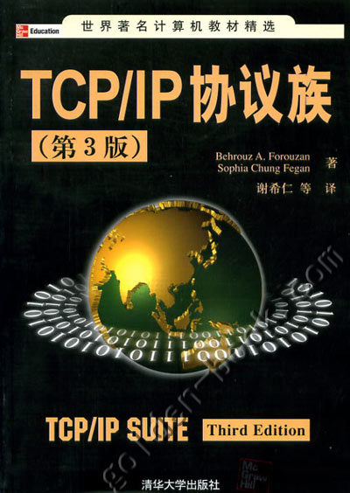
Reference Books
Notes:
Networking technologies have become an integral part of everyday life which has led to a dramatic increase in the number of professions where it is important to understand network technologies.
TCP/IP Protocol Suite teaches students and professionals with no prior knowledge of TCP/IP everything they need to know about the subject.
This comprehensive book uses hundreds of figures to make technical concepts easy to grasp, as well as many examples which help tie the material to the real world.
The second edition of TCP/IP Protocol Suite has been fully updated to include all of the recent technology changes in the field.
Many new chapters have been added such as one on Mobile IP, Multimedia and Internet, Network Security, and IP over ATM.
Additionally, out-of-date material has been overhauled to reflect recent changes in technology.
Chapter 1 Introduction 1
Chapter 2 The OSI Model and the TCP/IP Protocol Suite 17
Chapter 3 Underlying Technologies 43
Chapter 4 IP Addresses: Classful Addressing 81
Chapter 5 IP Addresses: Classless Addressing 115
Chapter 6 Delivery, Forwarding, and Routing of IP Packets 131
Chapter 7 ARP and RARP 159
Chapter 8 Internet Protocol (IP) 179
Chapter 9 Internet Control Message Protocol (ICMP) 211
Chapter 10 Internet Group Management Protocol (IGMP) 237
Chapter 11 User Datagram Protocol (UDP) 255
Chapter 12 Transmission Control Protocol (TCP) 275
Chapter 13 Stream Control Transmission Protocol (SCTP) 345
Chapter 14 Unicast Routing Protocols (RIP, OSPF, and BGP) 385
Chapter 15Multicasting and Multicast Routing Protocols 437
Chapter 16 Host Configuration: BOOTP and DHCP 457
Chapter 17 Domain Name System (DNS) 471
Chapter 18 Remote Login: TELNET 499
Chapter 19 File Transfer: FTP and TFTP 519
Chapter 20 Electronic Mail: SMTP, POP, and IMAP 547
Chapter 21 Network Management: SNMP 575
Chapter 22 World Wide Web: HTTP 599
Chapter 23 IP over ATM 621
Chapter 24 Mobile IP 637
Chapter 25 Multimedia 651
Chapter 26 Private Networks, Virtual Private Networks, and Network Address Translation 679
Chapter 27 Next Generation: IPv6 and ICMPv6 689
Chapter 28 Network Security 727
Appendix A ASCII Code 771
Appendix B Numbering Systems 776
Appendix C Checksum 783
Appendix D Error Detection 790
Appendix E Project 802 799
Appendix F Contact Addresses 803
Appendix G RFCs 805
Appendix H UDP and TCP Ports 807
Glossary 809
References 833
Index 835

Slide 27
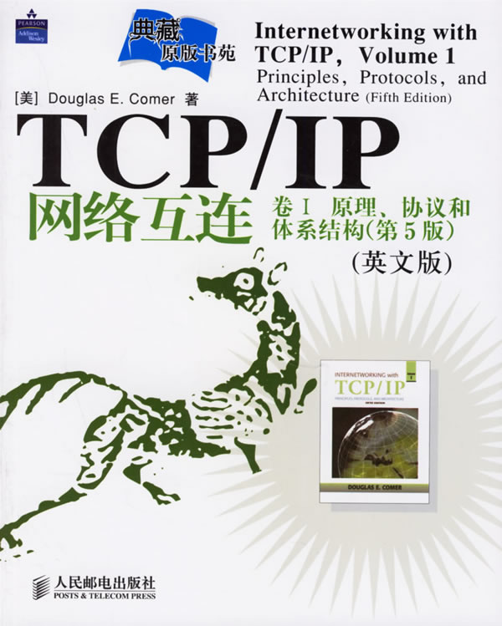

Reference Books
Notes:
Editorial Review:
Written by a best-selling author and leading computer networking authority, this updated book builds a comprehensive picture of the technologies behind Internet applications.
It answers the basic question "how do computer networks and Internets operate?" in the broadest sense and includes an early optional introduction to network programming and applications.
The book provides a comprehensive, self-contained tour through all of networking from the lowest levels of data transmission and wiring to the highest levels of application software, explaining how underlying technologies provide services and how Internet applications use those services.
At each level, it shows how the facilities and services provided by lower levels are used and extended in the next level. Emphasis on Internet technologies and applications provides readers with substantial sections on Internetworking and Network Applications. For individuals with little or no background in the subject.
Hi, Recently I purchased a book "Computer and Internet Applications" by Douglas. E. Comer. It is a used book and yet it is in great condition. There are some pages that are marked with pen otherwise the book was maintained well before the purchase. I am satisfied with the purchase.

Slide 28
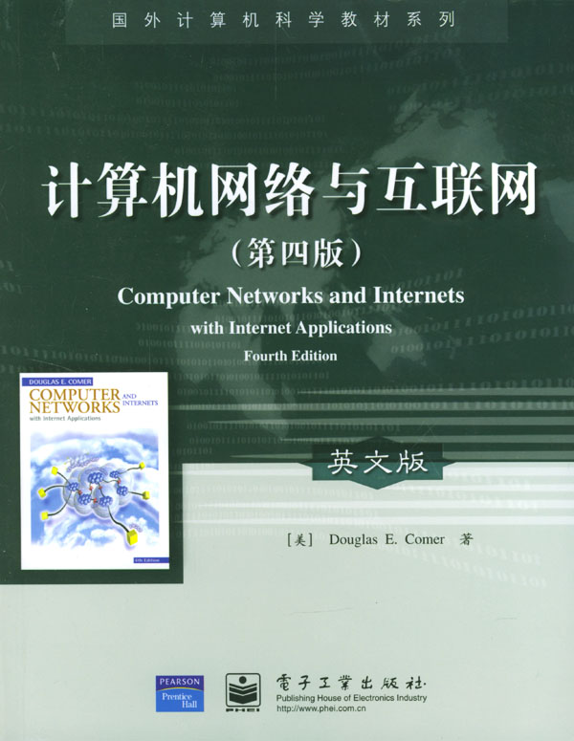
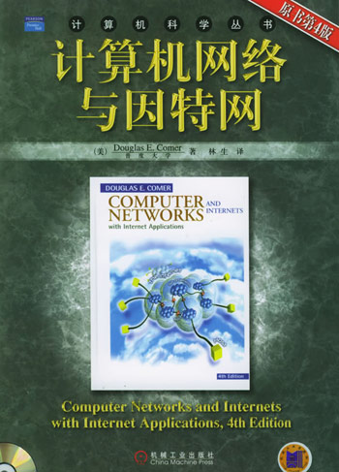
Reference Books
Notes:
Chapter 1 Introduction Chapter 2 Motivation and Tools Chapter 3 Network Programming and Applications
PART 2 Data Transmission Chapter 4 Transmission Media Chapter 5 Local Asynchronous Communication(RS-232) Chapter 6 Long-Distance Communication (Carriers, Modulation,and Modems)
PART 3 Packet Transmission Chapter 7 Packets, Frames, and Error Detection Chapter 8 LAN Technologies and Network Topology Chapter 9 Hardware Addressing and Frame Type Identification Chapter 1 LAN Wiring, Physical Topology, and Interface Hardware Chapter 11 Extending LAN s: Fiber Modems, Repeaters, Bridges,and Switches Chapter 12 Long-Distance and Local Loop Digital Technologies Chapter 13 WAN Technologies and Routing Chapter 14 Connection-Oriented Networking and ATM Chapter 15 Network Characteristics: Ownership, Service Paradigm, and Performance Chapter 16 Protocols and Layering
PART 4 Internetworking Chapter 17 Internetworking: Concepts, Architecture, and Protocols Chapter 18 IP: Internet Protocol Addresses Chapter 19 Binding Protocol Addresses (ARP) Chapter 20 IP Datagrams and Datagram Forwarding Chapter 21 IP Encapsulation, Fragmentation, and Reassembly Chapter 22 The Future IP(Ipv6) Chapter 23 An Error Reporting Mechanism (ICMP) Chapter 24 UDP: Datagram Transport Service Chapter 25 TCP: Reliable Transport Service Chapter 26 Network Address Translation Chapter 27 Internet Routing
PART 5 Network Applications Chapter 28 Client-Server Interaction Chapter 29 The Socket Interface Chapter 3 Example Of A Client and A Server Chapter 31 Naming with The Domain Name System Chapter 32 Electronic Mail Representation and Transfer Chapter 33 IP Telephony (VowwwlP) Chapter 34 File Transfer and Remote File Access Chapter 35 Word Wide Web Pages and Browsing Chapter 36 Dynamic Web Document Technologies (CGI, ASP, JSP, PHP, ColdFusion) Chapter 37 Active Web Document Technologies (Java, JavaScript) Chapter 38 RPC and Middleware Chapter 39 Network Management (SNMP) Chapter 4 Network Security Chapter 41 Initialization (Configuration) Appendix 1 Glossary Of Networking Terms and Abbreviations Appendix 2 The ASCII Character Set Appendix 3 Address Masks In Dotted Decimal Appendix 4 How To Use The CD-ROM Included With This Book Bibliography Index
第一部分 使用和构建因特网应用
第1章 概论 2
1.1 计算机联网的发展过程 2
1.2 网络系统的复杂性 2
1.3 把握复杂性问题 3
1.4 概念与术语 3
1.5 实战经验的价值 3
1.6 本书的组织结构 3
1.7 小结 4
第2章 推动力与工具 5
2.1 概述 5
2.2 资源共享 5
2.3 因特网的成长 6
2.4 探测因特网 7
2.5 对ping响应的解释 8
2.6 跟踪路径 9
2.7 小结 10
练习题 11
第3章 网络编程及应用 12
3.1 概述 12
3.2 网络通信 12
3.3 客户/服务器计算 12
3.4 通信模式 13
3.5 应用编程接口举例 13
3.6 粗识API 13
3.7 API的定义 14
3.8 echo应用程序源码 16
3.9 聊天应用程序源码 20
3.10 Web应用程序源码 24
3.11 用Select函数管理多个连结 29
3.12 小结 30
练习题 30
第二部分 数据传输
第4章 传输介质 34
4.1 概述 34
4.2 铜导线 34
4.3 光纤 35
4.4 无线电 35
4.5 人造卫星 36
4.6 地球同步卫星 36
4.7 低地球轨道卫星 37
4.8 低地球轨道卫星阵列 37
4.9 微波 38
4.10 红外线 38
4.11 激光 38
4.12 小结 38
练习题 38
第5章 局域异步通信 40
5.1 概述 40
5.2 异步通信的需求 40
5.3 用电信号发送位串 40
5.4 通信标准 40
5.5 波特率、帧和差错 42
5.6 半双工与全双工异步通信 43
5.7 实际硬件的限制 44
5.8 硬件带宽与位串传输 44
5.9 噪声对通信的影响 45
5.10 数据联网的意义 45
5.11 小结 46
进一步学习资料 46
练习题 46
第6章 远距离通信 48
6.1 概述 48
6.2 远程信号传输 48
6.3 用于调制与解调的硬件 50
6.4 租用的模拟数据线路 50
6.5 光波、射频和拨号调制解调器 51
6.6 载波频率与多路复用 52
6.7 基带与宽带技术 53
6.8 波分多路复用 53
6.9 扩展频谱 54
6.10 时分多路复用 54
6.11 小结 55
练习题 55
第三部分 分组传输
第7章 分组、帧与差错检测 58
7.1 概述 58
7.2 分组的概念 58
7.3 分组和时分多路复用 59
7.4 分组和物理帧 60
7.5 字节充填 61
7.6 传输差错 62
7.7 奇偶位与奇偶校验 62
7.8 概率、数学与差错检测 63
7.9 用校验和检测差错 63
7.10 用循环冗余校验检测差错 64
7.11 组合构件 65
7.12 突发性差错 66
7.13 帧格式和差错检测机制 66
7.14 小结 67
练习题 67
第8章 局域网技术与网络拓扑 69
8.1 概述 69
8.2 直接点对点通信 69
8.3 共享通信信道 70
8.4 局域网的重要性与访问的局部性 71
8.5 局域网拓扑结构 71
8.6 总线型网络实例：以太网 73
8.7 多址接入网上的载波侦听 74
8.8 CSMA/CD的冲突检测与退避 75
8.9 802.11b无线局域网与CSMA/CA 76
8.10 另一个总线型网络实例：LocalTalk 77
8.11 环型拓扑与令牌传递 77
8.12 自愈型令牌传递网 79
8.13 星型网络实例：ATM 80
8.14 小结 80
练习题 81
第9章 硬件寻址与帧类型标识 82
9.1 概述 82
9.2 指定接收方 82
9.3 局域网硬件如何用地址过滤帧 83
9.4 物理地址格式 84
9.5 广播 85
9.6 组播 85
9.7 组播地址 86
9.8 标识帧的内容 86
9.9 帧头部与帧格式 87
9.10 帧格式例子 87
9.11 关于无自标识帧的网络 88
9.12 网络分析器、物理地址和帧类型 90
9.13 小结 91
进一步的学习资料 91
练习题 91
第10章 局域网布线、物理拓扑与接口硬件
10.1 概述 93
10.2 局域网和计算机的速度 93
10.3 网络接口硬件 93
10.4 NIC与网络之间的连接 95
10.5 原始粗缆以太网布线 95
10.6 连接复用 96
10.7 细缆以太网布线 97
10.8 双绞线以太网 98
10.9 各种布线方案的优缺点 99
10.10 拓扑悖论 100
10.11 网络接口卡与布线方案 101
10.12 10/100网络接口与自动协商 102
10.13 网线分类 102
10.14 布线方案与其他网络技术 102
10.15 小结 103
进一步学习资料 104
练习题 104
第11章 局域网扩展技术 105
11.1 概述 105
11.2 距离限制与局域网设计 105
11.3 光纤扩展 105
11.4 中继器 106
11.5 网桥 108
11.6 帧过滤 109
11.7 桥接式网络的启动与稳态特性 110
11.8 规划桥接式网络 110
11.9 大楼之间的桥接 110
11.10 更远距离上的桥接 111
11.11 网桥回路 112
11.12 分布生成树 113
11.13 交换 114
11.14 交换机与集线器组合应用 115
11.15 其他组网技术的桥接和交换 115
11.16 小结 115
练习题 116
第12章 远程和本地回路数字技术 117
12.1 概述 117
12.2 数字电话 117
12.3 同步通信 118
12.4 数字线路及其相关设备 119
12.5 电话标准 120
12.6 DS术语与数据速率 120
12.7 较低容量线路 121
12.8 中等容量数字线路 121
12.9 最高容量线路 122
12.10 光载体线路标准 122
12.11 C后缀 122
12.12 同步光纤网 123
12.13 本地用户回路 124
12.14 ISDN 124
12.15 不对称数字用户线技术 124
12.16 其他数字用户线技术 126
12.17 电缆调制解调技术 127
12.18 上行流通信 128
12.19 混合光纤电缆 129
12.20 光纤到户 130
12.21 头端与尾端调制解调器 130
12.22 特殊场合下的无线技术 130
12.23 广播卫星系统 131
12.24 小结 132
练习题 132
第13章 广域网技术与路由 134
13.1 概述 134
13.2 大型网络与广域概念 134
13.3 分组交换机 134
13.4 广域网的构成 135
13.5 存储/转发 136
13.6 广域网的物理编址 136
13.7 下一跳转发 137
13.8 源地址独立性 137
13.9 分层地址与路由的关系 138
13.10 广域网中的路由 139
13.11 默认路径的使用 140
13.12 路由表计算 140
13.13 图的最短路径计算 141
13.14 分布式路径计算 142
13.15 距离矢量路由 143
13.16 链路状态路由 144
13.17 广域网技术实例 144
13.18 小结 146
练习题 146
第14章 面向连结型网络与ATM 147
14.1 概述 147
14.2 单一的全局网络 147
14.3 ISDN与ATM 147
14.4 ATM设计与信元 147
14.5 面向连结型服务 149
14.6 VPI/VCI 149
14.7 标记与标记交换 149
14.8 通过ATM网络的转发过程 150
14.9 永久型虚线路 151
14.10 交换型虚线路 152
14.11 服务质量 152
14.12 采用信元和标记交换的动机 153
14.13 ATM数据传输与AAL5 153
14.14 对ATM的评价 154
14.15 多协议标记交换 155
14.16 小结 155
练习题 155
第15章 网络所有权、服务模式和性能 157
15.1 概述 157
15.2 网络所有权 157
15.3 专用与公用网络 158
15.4 优点与缺点 158
15.5 虚拟专用网络 159
15.6 保证绝对隐私 159
15.7 服务模式 160
15.8 面向连结型服务模式 160
15.9 无连结型服务模式 161
15.10 内部和外部服务模式 161
15.11 服务模式比较 161
15.12 服务模式举例 162
15.13 地址与连结标识符 162
15.14 网络性能特征 163
15.15 抖动 166
15.16 小结 166
练习题 167
第16章 协议与分层 168
16.1 概述 168
16.2 协议的必要性 168
16.3 协议组 168
16.4 协议设计规划 169
16.5 七层功能 169
16.6 栈：分层软件 170
16.7 分层软件如何工作 171
16.8 多层嵌套的头部 171
16.9 分层的科学依据 172
16.10 协议所采用的技术 172
16.11 协议设计技巧 178
16.12 小结 178
练习题 179
第四部分 网络互联
第17章 网络互联：概念、结构与协议 182
17.1 概述 182
17.2 网络互联的动机 182
17.3 全局服务概念 182
17.4 异构网络中的全局服务 183
17.5 网络互联 183
17.6 用路由器连接物理网络 183
17.7 互联网体系结构 184
17.8 实现全局服务 184
17.9 虚拟网络 185
17.10 网络互联协议 186
17.11 网络互联及TCP/IP的重要性 186
17.12 分层与TCP/IP协议 186
17.13 主机、路由器及协议层 187
17.14 小结 188
练习题 188
第18章 网际协议地址 189
18.1 概述 189
18.2 虚拟互联网的地址 189
18.3 lP编址方案 190
18.4 lP地址的层次结构 190
18.5 IP地址的原分类 190
18.6 地址类别的计算 191
18.7 点分十进制表示法 192
18.8 类别与点分十进制表示法 193
18.9 地址空间的划分 193
18.10 地址的授权 193
18.11 有类编址举例 194
18.12 子网与无类编址 194
18.13 地址掩码 195
18.14 CIDR表示法 196
18.15 CIDR地址块举例 196
18.16 CIDR主机地址 196
18.17 特殊IP地址 197
18.18 特殊IP地址小结 199
18.19 伯克利广播地址形式 199
18.20 路由器与IP寻址原理 199
18.21 多穴主机 200
18.22 小结 200
练习题 201
第19章 协议地址绑定 202
19.1 概述 202
19.2 协议地址和分组传递 202
19.3 地址解析 202
19.4 地址解析技术 203
19.5 查表法地址解析 204
19.6 封闭式计算法地址解析 205
19.7 报文交换法地址解析 205
19.8 地址解析协议 206
19.9 ARP报文传递 206
19.10 ARP报文格式 207
19.11 发送ARP报文 208
19.12 识别ARP帧 208
19.13 高速缓存ARP响应 209
19.14 收到ARP报文的处理 209
19.15 分层、地址解析、协议地址 210
19.16 小结 210
练习题 211
第20章 IP数据报和数据报转发 212
20.1 概述 212
20.2 无连结服务 212
20.3 虚拟分组 212
20.4 IP数据报 213
20.5 IP数据报转发 214
20.6 IP地址与路由表项 214
20.7 掩码域与数据报转发 215
20.8 目的地与下一站地址 216
20.9 尽力传递 216
20.10 IP数据报头部格式 216
20.11 小结 217
练习题 217
第21章 IP封装、分片与重装 219
21.1 概述 219
21.2 数据报传输与帧 219
21.3 封装 219
21.4 通过互联网传输 220
21.5 MTU、数据报长度及封装 221
21.6 重装 222
21.7 标识数据报 223
21.8 片丢失问题 223
21.9 分片再分片 223
21.10 小结 223
练习题 224
第22章 未来的I P 225
22.1 概述 225
22.2 IP成功之处 225
22.3 改革的动机 225
22.4 名称和版本号 226
22.5 IPv6的特点 226
22.6 IPv6数据报格式 227
22.7 IPv6基本头部的格式 227
22.8 IPv6如何处理多重头部 228
22.9 分片、重装和通路MTU 229
22.10 采用多重头部的目的 230
22.11 IPv6编址 230
22.12 IPv6冒分十六进制数表示法 231
22.13 小结 232
练习题 232
第23章 差错报告机制 233
23.1 概述 233
23.2 尽力服务语义和差错检测 233
23.3 互联网控制报文协议 233
23.4 ICMP报文传送 235
23.5 利用ICMP报文测试可达性 236
23.6 利用ICMP跟踪路径 236
23.7 利用路径跟踪程序打印出最后的地址 236
23.8 利用ICMP发现通路MTU 237
23.9 小结 238
练习题 238
第24章 数据报传送服务 239
24.1 概述 239
24.2 端到端传送协议的必要性 239
24.3 用户数据报协议 239
24.4 无连结的通信模式 240
24.5 面向报文的接口 240
24.6 UDP通信语义 240
24.7 任意的交互通信 241
24.8 支持单播、组播和广播 241
24.9 用协议端口号标识端点 241
24.10 UDP数据报格式 242
24.11 UDP校验和及伪头部 242
24.12 UDP封装 243
24.13 小结 243
练习题 243
第25章 可靠的传输服务 245
25.1 概述 245
25.2 可靠传输的必要性 245
25.3 传输控制协议 245
25.4 TCP为应用提供的服务 245
25.5 端到端服务与数据报 246
25.6 实现可靠性 247
25.7 分组丢失与重传 247
25.8 自适应重传 248
25.9 重传时间的比较 248
25.10 缓冲、流控与窗口 249
25.11 三次握手 250
25.12 拥塞控制 251
25.13 TCP段格式 251
25.14 小结 252
练习题 252
第26章 网络地址转换 254
26.1 概述 254
26.2 要求使用惟一地址 254
26.3 网络地址转换技术 254
26.4 NAT拓扑 254
26.5 NAT的可能实现 255
26.6 基本的地址转换技术 255
26.7 地址转换表 256
26.8 NAPT与TCP拼接 256
26.9 其他转换技术：双NAT和CAT 257
26.10 家用NAT软件和系统 257
26.11 小结 258
进一步的阅读资料 258
练习题 258
第27章 因特网路由技术 259
27.1 概述 259
27.2 静态与动态路由 259
27.3 主机静态路由与默认路径 259
27.4 动态路由与路由器 260
27.5 全球因特网的路由技术 261
27.6 自治系统概念 261
27.7 两类因特网路由协议 262
27.8 路径与数据业务 264
27.9 边界网关协议 264
27.10 路由信息协议 265
27.11 RIP分组格式 266
27.12 开放最短通路优先协议 267
27.13 OSPF图的例子 267
27.14 OSPF区域 268
27.15 组播路由技术 268
27.16 小结 271
练习题 271
第五部分 网络应用
第28章 客户/服务器交互 274
28.1 概述 274
28.2 应用软件提供的功能 274
28.3 互联网提供的功能 274
28.4 建立通信连结 275
28.5 客户/服务器模式 275
28.6 客户和服务器特性 275
28.7 服务器程序和服务器类计算机 276
28.8 请求、响应和数据流方向 276
28.9 传输协议与客户/服务器交互 277
28.10 一台计算机上的多种服务 277
28.11 标识一个特定服务 278
28.12 单个服务的多个服务器副本 278
28.13 动态服务器创建 279
28.14 传输协议与无二义性通信 279
28.15 面向连结传输与无连结传输 280
28.16 支持多协议的服务 280
28.17 复杂的客户/服务器交互 280
28.18 交互与循环依赖问题 281
28.19 小结 281
练习题 282
第29章 套接字接口 283
29.1 概述 283
29.2 应用程序接口 283
29.3 套接字API 283
29.4 套接字与套接字库 284
29.5 套接字通信与UNlX I/O 284
29.6 套接字、描述符与网络I/O 285
29.7 参数与套接字API 285
29.8 实现套接字APl的过程 285
29.9 用套接字进行读写 290
29.10 其他套接字过程 290
29.11 套接字、线程和继承性 291
29.12 小结 291
练习题 292
第30章 客户与服务器举例 293
30.1 概述 293
30.2 面向连结型通信 293
30.3 一个服务例子 293
30.4 例程中的命令行参数 293
30.5 套接字过程调用的顺序 294
30.6 客户例程源代码 295
30.7 服务器例程源代码 297
30.8 流服务与多次recv调用 299
30.9 套接字过程与阻塞 299
30.10 程序代码长度与差错报告 300
30.11 客户例程用于另一种服务 300
30.12 用另一种客户程序来测试服务器 300
30.13 小结 301
练习题 301
第31章 域名系统的命名机制 303
31.1 概述 303
31.2 计算机名字的结构 303
31.3 地理结构 304
31.4 组织范围内的域名 305
31.5 以WWW开头的域名 306
31.6 DNS客户/服务器模型 307
31.7 DNS服务器层次结构 307
31.8 服务器体系结构 307
31.9 访问局部性与多服务器 308
31.10 服务器间的链接关系 309
31.11 名字解析 309
31.12 DNS性能的优化 310
31.13 DNS记录项的类型 311
31.14 使用CNAME类型的别名 311
31.15 多重类型的重要影响 312
31.16 缩写与DNS 312
31.17 小结 312
练习题 313
第32章 电子邮件表示与传输 314
32.1 概述 314
32.2 电子邮件工作模式 314
32.3 电子邮箱与地址 314
32.4 电子邮件报文格式 315
32.5 抄送副本 316
32.6 多用途因特网邮件扩展 317
32.7 电子邮件与应用程序 318
32.8 邮件传输 318
32.9 简单邮件传输协议 318
32.10 对一台计算机上多个接收者的优化 320
32.11 邮件分发、列表与转发 320
32.12 邮件网关 321
32.13 自动邮递列表 321
32.14 邮件中继与电子邮件地址 322
32.15 访问邮箱 323
32.16 拨号连接与POP 324
32.17 小结 324
练习题 324
第33章 IP电话 326
33.1 概述 326
33.2 IP电话的动机与挑战 326
33.3 编码、传输和重播 326
33.4 信令系统和协议 327
33.5 基本的IP电话系统 327
33.6 与其他电话系统的互操作 328
33.7 其他术语和概念 328
33.8 建议的协议及所在层次 330
33.9 H.323特性 330
33.10 H.323分层 331
33.11 SIP特性和用户标识 331
33.12 SIP方法 331
33.13 SIP会话举例 332
33.14 电话号码映射及路由 332
33.15 IP电话及电源 333
33.16 小结 333
进一步的阅读资料 334
练习题 334
第34章 文件传送与远程文件访问 335
34.1 概述 335
34.2 文件传送问题的通用化 335
34.3 文件传送协议 335
34.4 FTP通用模型与用户界面 336
34.5 FTP命令 336
34.6 连结、验证与文件权限 337
34.7 匿名文件访问 337
34.8 任意方向的文件传送 338
34.9 文件名的通配符扩展 338
34.10 文件名转换 338
34.11 改变目录与列出内容 339
34.12 文件类型与传送模式 339
34.13 FTP对话的例子 340
34.14 冗长输出 341
34.15 FTP的客户/服务器交互 342
34.16 控制连结与数据连结 342
34.17 数据连结与文件结束 343
34.18 小型文件传送协议 343
34.19 网络文件系统 343
34.20 小结 344
练习题 345
第35章 WWW页面与浏览 346
35.1 概述 346
35.2 浏览器界面 346
35.3 超文本与超媒体 346
35.4 文档表示 346
35.5 HTML格式与表示 347
35.6 HTML格式标签举例 348
35.7 标题字 348
35.8 列表 349
35.9 Web页面中嵌入图形图像 349
35.10 标识页面 350
35.11 文档之间的超文本链接 350
35.12 客户/服务器交互 351
35.13 Web文档传输与HTTP 351
35.14 浏览器结构 352
35.15 可选的客户 353
35.16 Web浏览器中的缓存 354
35.17 HTTP对缓存的支持 355
35.18 其他传输协议 355
35.19 其他标记语言 355
35.20 小结 356
练习题 356
第36章 动态Web文档技术 358
36.1 概述 358
36.2 Web文档的三种基本形式 358
36.3 每种文档类型的伏缺点 358
36.4 动态文档的实现 359
36.5 CGI标准 359
36.6 CGI程序的输出 360
36.7 CGI程序举例 360
36.8 参数和环境变量 361
36.9 状态信息与cookies 362
36.10 带长期状态信息的CGI脚本 363
36.11 带短期状态信息的CGl脚本 364
36.12 表格与交互 366
36.13 服务器端的脚本技术 366
36.14 小结 367
练习题 368
第37章 活动Web文档技术 369
37.1 概述 369
37.2 连续更新显示的推-拉技术 369
37.3 活动文档与服务器开销 369
37.4 活动文档的表示与转换 370
37.5 Java技术 370
37.6 Java程序设计语言 371
37.7 Java运行环境 372
37.8 Java类库 373
37.9 图形工具箱 373
37.10 在特定计算机上使用Java图形功能 374
37.11 Java解释器和浏览器 375
37.12 编译Java程序 375
37.13 applet实例 375
37.14 调用applet 377
37.15 与浏览器交互的例子 377
37.16 差错和异常处理 379
37.17 JavaScript技术 379
37.18 替代技术 380
37.19 小结 381
练习题 381
第38章 RPC和中间件 383
38.1 概述 383
38.2 客户和服务器编程 383
38.3 远过程调用模式 383
38.4 RPC模式 384
38.5 通信插件 385
38.6 外部数据表示 386
38.7 中间件和面向对象的中间件 387
38.8 小结 389
练习题 390
第39章 网络管理 391
39.1 概述 391
39.2 互联网的管理 391
39.3 潜在故障的危险性 391
39.4 网络管理软件 391
39.5 客户、服务器、管理员与代理 392
39.6 简单网络管理协议 392
39.7 取/存操作模式 393
39.8 管理信息库和对象名 393
39.9 MIB变量的种类 393
39.10 对应于数组的MIB变量 394
39.11 小结 394
练习题 395
第40章 网络安全 396
40.1 概述 396
40.2 安全网络与安全策略 396
40.3 安全性内容 396
40.4 安全责任与控制 397
40.5 完整性机制 397
40.6 访问控制与口令 397
40.7 加密与保密 398
40.8 公共密钥加密 398
40.9 数字签名的鉴别 399
40.10 因特网防火墙概念 399
40.11 利用端口进行分组过滤 400
40.12 利用分组过滤器构建防火墙 401
40.13 虚拟专用网络 402
40.14 隧道技术 403
40.15 安全性技术 403
40.16 小结 404
练习题 404
第41章 初始化 406
41.1 概述 406
41.2 自举协议软件 406
41.3 协议参数 406
41.4 协议配置 407
41.5 需要配置的项目举例 407
41.6 利用存储文件进行配置 407
41.7 自动协议配置的必要性 407
41.8 自动协议配置的方法 408
41.9 用于发现地址的地址 408
41.10 自举过程中使用的协议顺序 409
41.11 自举协议 409
41.12 动态主机配置协议 410
41.13 DHCP的优化 411
41.14 通过中继间接访问服务器 412
41.15 DHCP报文格式 412
41.16 DHCP与域名 413
41.17 小结 413
练习题 413
第六部分 附录
附录1 网络术语与缩写词汇编 416
附录2 ASCII字符集 438
附录3 点分十进制数表示的地址掩码 439
附录4 如何使用随书附带的光盘 440
参考文献 443
第4版 修订...

Slide 29
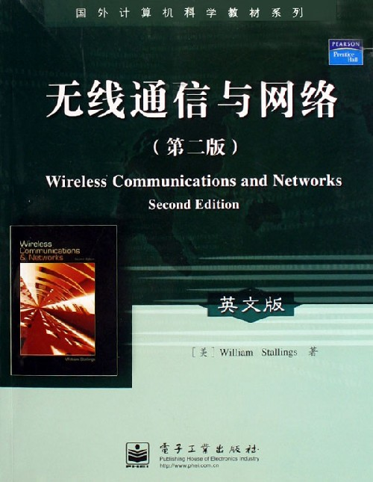
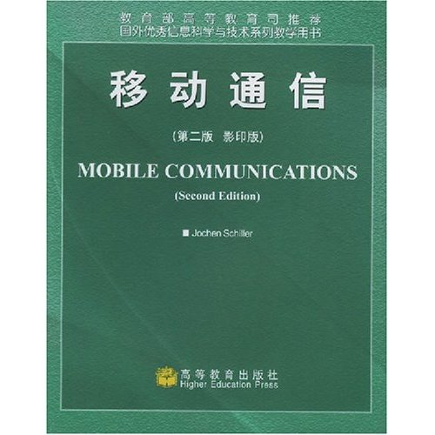
Reference Books

Slide 30


Reference Books
Notes:
Product Description Local Area Networks (LANs) have become an integral part of communication in today's world. LAN applications are used in businesses, educational facilities, hospitals, stock exchanges, and warehouses to name a few.
Forouzan's Local Area Networks offers reader-friendly, comprehensive coverage of LAN technologies, which prepares students the reader to use these technologies in real-world applications. Local Area Networks is ideal for students both in the classroom and later as a reference.
Forouzan motivates topics by practical applications, and his liberal use of figures makes difficult technical topics easier to grasp by providing an intuitive, visual representation of concepts. Extensive practice sets are also provided at the end of each chapter, which reinforce what the student has learned.
Forouzan's Local Area Networks is also up-to-date. It presents in-depth material on such current topics as Gigabit Ethernet, ATM LAN, Wireless LAN, VPN, and VLAN.

Slide 31


Reference Books
Notes:
第一部分 计算机网络软件编程训练要求与教学指导
第1章 计算机网络课程内容、编程训练目的与教学指导
1.1 计算机网络课程特点与网络软件人才需求的形势
1.2 计算机网络技术的研究与发展
1.2.1 发展主线1：Internet技术
1.2.2 发展主线2：无线网络技术
1.2.3 发展主线3：网络安全技术
1.2.4 总结
1.3 《计算机网络高级教程》的相关内容安排
1.3.1 计算机网络技术的研究与发展
1.3.2 广域网技术
1.3.3 局域网技术
1.3.4 城域网技术
1.3.5 IPv4协议
1.3.6 IPv6协议
1.3.7 移动IP协议
1.3.8 TCP与UDP协议
1.3.9 网络应用和应用层协议
1.3.10 无线Ad hoc网络、无线传感器网络与无线网格网研究
1.3.11 网络安全与网络管理技术的研究
1.3.12 网络性能分析、网络模拟与开源工具包
1.4 网络软件编程课题训练目的与基本内容
1.4.1 基础类网络软件编程课题训练目的与基本内容
1.4.2 综合类网络软件编程课题训练目的与基本内容
1.4.3 提高类网络软件编程课题训练目的与基本内容
1.4.4 网络软件编程训练选题指导
第二部分 基础训练篇
第2章 Ethernet帧结构解析程序
第3章 使用ARP协议获取局域网内活动主机物理地址
第4章 计算校验和程序
第5章 IP包流量分析程序
第6章 Tracert程序
第7章 IPv6报文封装及地址生成程序
第8章 TCP和UDP数据包发送程序
第9章 基于C/S接的套接字程序设计
第10章 滑动窗口协议模拟程序
第11章 Web Server程序
第12章 无线局域网802.11协议CSMA/CA算法模拟程序
第13章 公钥密码实现程序
第三部分 综合训练篇
第14章 路由器基本功能实现程序
第15章 FTP协议实现程序
第16章 协议分析器程序
第17章 综合扫描器程序
第四部分 提高训练篇
第18章 基于SNMP协议的网络拓补发现程序
第19章 利用OpenSSL实现安全的Web Server程序
第20章 简单防火墙程序
第21章 防火墙扩展功能程序
第22章 NS-2简单有线网络模拟程序
第23章 使用NS-2模拟无线Ad hoc网络
附录A Winpcap简介与使用说明
附录B Windows Driver Module简介
附录C NS-2在Linux和Windows + Cygwin下的安装
参考文献

Slide 32
Prerequisites and Demands
Attendance at lectures is a requirement.
Each student needs to attend all the lectures.
If you miss a lecture, it is your responsibility to find out if there were any important announcements made.
To preview the contents of the lecture is a requirement before class.
To preview the lab is a requirement before experiment.
Hand in Exercises book on time.

Slide 33
Some words for College Students
This course will make you on your journey to be an expert of computer networking …
你将从此开始计算机网络专家的成长之旅…

Slide 34

Some words for College Students
网络技术：一类技术而非一门技术
理论基础
工程技术
应用技术
管理技术
安全技术
开发技术
各种新技术新产品层出不穷，令人应接不暇
基础理论基本原理并未改变，万变不离其宗
刘晓庆对人们说:
“做女人难,做名女人更难”。
陈老师对你们说:
“学计算机难,学计算机网络更难”。
正因为其“难”，学好才有特别的价值。

Slide 35
Some words for College Students
Some Hot Issues in the Computer sciences realm
Previous hot issues:
Two Os: Object-Oriented; Open Systems;
Two Ms: Multimedia; Massive Parallel Processing
One N: Network
Most current and future hot issues:
Embedded System;
Distributed-Object;
Distributed Computing;
Virtual Reality;
Cluster Systems;
Cluster Component;
Grid Computing;
information security;
Mobile Computing;
Intelligence computing

Slide 36
三种网络技术人才
专家学者型 研究生层次培养
较深理论基础、从事研究开发
工程师型 本科生层次培养 √
理解和掌握网络原理和常用协议；
网络性能分析和网络编程；
熟悉各种技术与设备；
规划制订网络系统集成方案；
施工员型 专、中专技校层次培养
网络理论知之不深， 施工布线等动手能力强
第二类人才：“上知天文(理论)，下知地理(实践)”

Slide 37
该课程的授课思路
以分组交换为背景，按照“通信是基础、协议是核心、互联是重点、应用是目标、QoS是导向、安全是关注”的要求；
遵从“因特网五层协议模型”由上到下的次序，依照“数据在计算机网络中的传输寻址过程和数据传输控制”的线索展开讲授和讨论。
传输寻址涉及到物理地址、逻辑地址、端口地址和专用地址等方面。
数据传输控制涉及到差错控制、通信量控制(如拥塞控制和流量控制)、服务质量控制和安全控制。

Slide 38
Contents and Scheduling
Syllabus (教学进度)
Computer Networks and the Internet 6 Periods
Application Layer 6 Periods
Transport Layer 8 Periods
The Network Layer 8 Periods
Link Layer and Local Area Networks 6 Periods
Wireless and Mobile Networks 6 Periods
Notes:
Computer Networks and the Internet: 5 Periods
Application Layer: 8 Periods
Transport Layer: 10 Periods
The Network Layer: 12 Periods
Link Layer and Local Area Networks: 9 Periods
Review 6 Periods
Labs: 30 Periods

Slide 39

Requirements and contact……
Textbook Web Pages
http://www.aw.com/kurose-ross
http://sites.sdjzu.edu.cn/jisuanjixi/jpkc/wl/kcjj.htm (山东建筑大学计算机网络原理精品课程网站)
http://202.113.72.224 (天津理工大学计算机网络原理精品课程网站)
Questions
Email: chenwenfu@cug.edu.cn
Tel: 13035110088

Slide 40
谢谢!
THANK
YOU

